Slide 1

ENABLING
SUCCESS
Nov 13, 2025

Slide 2
STAKEHOLDER INTERVIEWS AND INPUTS
Jawad Shafique
(ADQ)
Mansoor Almarzooqi
(ADQ)
Abdullah Tahlak
(ADQ)
$
VALUE
Lucasz Wozniak
(ADQ)
Hamad Al Shehhi
(ADQ)
Ahmed AlMehairi
Group CEO
STRATEGIC PIVOTS
Adeel Ghias
(Head of Front Office)
Ammar Mian
(Acting Chief Financial Officer)
Christoffer Nielsen
(Chief Information Officer)
Ludovic Lombard
(Head of Risk)
Vimal Kumar
(Acting Chief Operation Officer)
Daniel Squires
(Chief Commercial Officer)
Deji Fatiregun – Head of Core Systems IT
Odafe Ojenikoh – Head of Engineering IT
Vijay Kumar Boyina – Senior Finance Manager
HOGAN
Hosam Hittini – SOC Manager Cybersecurity, Risk
Saikat Sengupta – Head of Data Engineering – Analytics
Muhammad Zuhaib – Financial Controller
Chris Dale – Head of Trading & Quant Analytics, Front Office
Nikos Tsoskounoglou – Head Quant Research, Front Office
Srijan Katyal – Global Head of Strategy and Client Services
Alia El Shazly – Head of Middle Office
Shady Mohamed – Director of Client Onboarding
Andrew Sherwood – Acting Head of Marketing
DOCUMENTS / INTAKE

Slide 3

STRATEGIC PIVOTS | ADSS GROUP JOURNEY
ALIGNED STRATEGIC PIVOTS
Transformation/clean-up approach focused on cost reductions and legacy issue resolution |  | Strategic, value-driven cost management that prioritizes investment in growth, digital transformation, and talent—ensuring every dollar saved directly enables ADSS’s long-term competitiveness and scalable business outcomes
Single‑product CFD broker |  | Multi‑product regional brokerage & wealth platform (cash equities, ETFs, ETDs, crypto, savings, institutional FX, white-label)
High‑concentration retail base with high churn |  | Diversified client mix (mass savers, affluent, HNWI, institutions) and a retention‑first commercial model (savings accounts, robo/advisory)
Fragmented legacy tech & manual operations |  | Unified digital backbone, scalable with exchange connectivity, APIs and automated client journeys
UAE‑only operations |  | MENA + Africa regional footprint with targeted local presence (local offices in KSA and South Africa; partnerships/remote servicing for Turkey and other markets)
Aligned on the Value Hotspots; Differences in Their Relative Importance
CEO
TRANSFORMATION / COST / LEGACY ISSUES
20%
GROWTH
50%
DIGITAL
30%
TRANSFORMATION / COST / LEGACY ISSUES
50%
GROWTH
30%
DIGITAL
20%
VS.

Slide 4
DIAGNOSTICS AND PRESENTING CHALLENGES AGAINST THE PIVOTS
CEO READINESS
ARE THE STAKEHOLDERS ALIGNED?
Limited evidence against Jobs To Be Done especially growth Orientation and leading Top teams
Limited evidence of situational leadership; hasn’t yet demonstrated the shift from investor to operating CEO.
Does not encourage open communication, no one challenges him or brings forward ideas; “manages through fear”.
Misalignment on growth vs. cost efforts (slide 4)
Digital strategy misalignment, no shared agreement on the company’s digital direction
Unfinished transformation and change fatigue within his team; continue to operate in “cleanup mode; no clear sense of completion and next steps
IS THE LEADERSHIP TEAM READY?
ARE WE TALENTED ENOUGH AT THE POINTS OF VALUE?
Fragmented Executive Team: silos often compete for the CEO’s approval
Team personalities; highly skeptical, task focused and low on empathy / relationships
Unclear ways of working and lack of information flow leading to politically cautious and transactional relations.
Support functions not commercially oriented
Most team members are new and capable, but some lack experience with Middle East culture
Have not assessed the critical roles. The resistance will come from:
Organization fatigue and distrust, cost-cutting, restructuring and job insecurity
Legacy workforce and readiness for change, many struggle to adapt to the new performance-driven culture
Underperformance masked by fear, pockets of underperformance remain unaddressed

Slide 5

OPPORTUNITIES FOR GREATER ALIGNMENT
CEO
N-1 and below
Cost discipline as a foundation for trust; increasingly acknowledges the need for growth
Feeling confused by cost-cutting vs. growth narrative from ADQ
Cost vs. Growth
Clarity and Consistency of Strategic Direction
Experience shifting focus, unclear goals, and inconsistent messaging
Communicates priorities 1:1, focusing on fixing issues
Transformation Fatigue vs. Momentum
“Open-heart surgery” as a necessary, bold intervention—even if it causes discomfort along the way.
Employees feel worn by constant transformation and unclear expectations
Frustrated by legacy platform and high costs; fragmented efforts; tries to solve it on his own
CIO unable to build relations with CEO leading to confusion and slow decision making
Pace of Digital Transformation

Slide 6
Executive Summary
WHO | ASSESSMENT & CONSIDERATIONS
Ahmed Almehairi CEO | Has been vital in stabilizing and transforming ADSS, demonstrating financial discipline and renewed board and shareholder trust Building on this solid foundation, the organization is now ready for its next pivotal phase. Ahmed will benefit from aligning with ADQ / Board on prioritization of growth in the next phase He can continue tightening and refining—but it doesn’t need to dominate the agenda or messaging Unify the C-suite, enable them to take greater ownership, collaborate more fully Now that you have built your team, flex your leadership style (situational leadership) based on team maturity—be hands‑on and directive with less experienced leaders; coach and delegate with more experienced ones Build a system that protects your authority but multiplies your impact (ways of working, meetings, communication, etc.)
Leadership Team | The team has been in the formation stage and now is a good time delegate and hold them accountable Hub and spoke is better in "fixing stage”—for the growth phase, the team needs to work inter-dependently, with cross-functional planning, communication routines, and standard ways of working (shared meetings and follow-ups to enable faster decision-making)
Organization | Clean-up and upskill: mediocrity probably persists in some areas Every function should identify critical roles that drive value—quietly remove or reassign underperformers who block progress Focus development and upskilling on the top 15–20% of talent—especially in growth-critical areas (commercial, operations, digital)

Slide 7
Messages
WHO | Skills | Behaviour | Moderator | ASSESSMENT & CONSIDERATIONS
Vimal Kumar Acting COO |  |  |  | Disciplined, process-driven, “a workhorse” suitable especially during periods of major operational change Over-used his power of the network- unintentionally limiting trust among stakeholders Can act as a constructive moderator who brings the leadership team together At the right time, replace COO with someone who has the experience required for the growth phase
Ammar Azhar CFO |  |  |  | Technically competent, seen as steady and credible by his peers Still junior in leadership experience and has not yet established his voice within the LT; probably less visible than he could be Need to become a thinking partner for the CEO Need to increase communication to and from the business (growth vs. Cost priorities; transparent communication)
Adeel Ghias Head of Front Office |  |  |  | Strengths lie in operational management Need to communicate the long-term strategy (“Day 2” vision) and future investment priorities to create engagement and direction Must develop & retain the team: empower critical roles and invest in visible career paths to retain and grow top talent
Ludovic Lombard Head of Risk |  |  |  | Technically strong, but rigid and confrontational—Culturally misaligned with the local context Under stress he may become critical, controlling, or impatient Need support from an executive coach focused on culture and collaboration (how to frame risk conversations commercially, not procedurally) Needs to get broader engagement for cross-functional initiatives
Dan Squires CCO |  |  |  | The CCO shows promise: high potential, commercially minded, aligned with growth goals However, being new to the region and culture, he currently avoids conflict by over-aligning with the CEO Support needed: cultural onboarding and visible sponsorship from CEO Needs to re-build marketing capabilities and strengthen his team capability and accountability (focus on 3–5 critical commercial roles, address underperformance, and invest in development for high-potential talent)

Slide 8
Messages
WHO | Skills | Behaviour | Moderator | ASSESSMENT & CONSIDERATIONS
Chris Rosenkilde CIO |  |  |  | He is seen as someone that is primarily oriented toward building for the future rather than fixing issues The CEO–CIO relationship is broken and has become a distraction; he needs to make effort to amend it and finalize the digital strategy Needs to strengthen influence and relationships with the CEO and peers; if the relationship cannot be re-built, the best course is to exit the CIO respectfully and quickly
Hessa Almaazmi CHRO |  |  |  | Replace the CHRO HR remains the weakest link: inconsistent promises, lack of policies, and no credibility The absence of HR governance is amplifying mistrust and underperformance
Diane Chief Compliance Officer |  |  |  | Rigid, low business acumen The compliance function currently blocks growth through procedural rigidity and limited commercial understanding; it requires either a strong coaching intervention to shift from a 'control' mindset to risk‑based enablement or replacement with a modern, business‑oriented compliance leader

Slide 9
KEY MESSAGES to the Leadership Team (co-create with the CEO)
Lead with Clarity –
Define clear Jobs to Be Done for each Chief and their teams to ensure alignment and accountability.
Continue the transformation with less noise—keep momentum internally while shifting the message toward growth.
Win as One Team
Strengthen the leadership team through biannual offsites and ongoing relationship-building (including informal team interactions).
Create expectation for the Chiefs to align early and proactively by flaging cross-functional impacts before decisions are finalized.
Create clear, structured ways of working with a consistent weekly and monthly operating cadence.
Use ExCo meetings to represent the enterprise priorities, not only individual functions.
Introduce a shared scorecard and feedback process for Chiefs, covering functional priorities and enterprise-wide leadership behaviors.
Elevate your Talents in your Team
Take ownership of performance management by addressing underperformance fairly, transparently, and without delay. This is not about broad exits but about removing blockers and reinforcing clear expectations.
Invest in upskilling the critical roles within each function—especially those directly linked to growth, delivery, and execution.
Strengthen business acumen across support functions to ensure they understand value creation and can actively contribute to commercial outcomes.
Organizational Energy
Regularly communicate as a unified executive group to the broader organization
Role Modelling Enterprise Values and Accountability

Slide 10




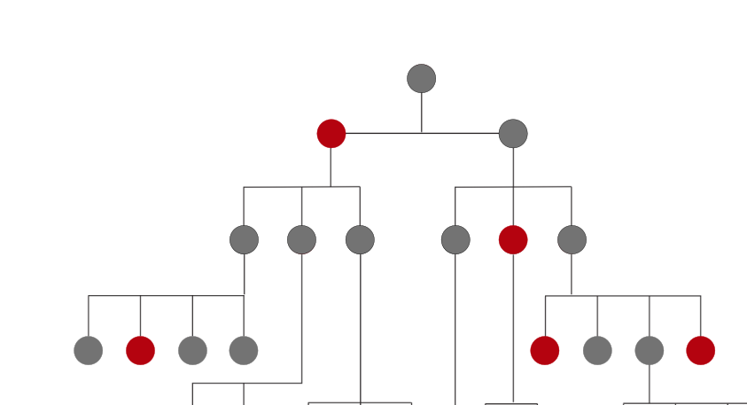

ADQ actions to enable the CEO
CLEAR, DIRECT
COMMUNICATION
FROM THE BOARD
Replacing the CEO at this point may de-stabilize the situation further
Focus on strengthening the structure below him—complementing his leadership gaps with a strong people-oriented leader (e.g., Dy CEO, CHRO) who can act as a stabilizing buffer and a coach.
NEXT STEPS
Shift his energy to growth: Champion a “1 dirham, 1.01 decision” mindset—ensuring spending is directly tied to measurable business outcomes
Give direct feedback on what's working and what's not and on the JTBDs—financial and non-financial (building a sustainable top team as a ADQ company is a JTBD)
ALIGN TEAM Incentives to encourage Team collaboration
FIX vs GROW
vs
Deliver key messages to CEO and N-1
Assess CEO’S receptiveness and coachability
Run a N-1 workshop (DEC)
DESIGN HIS ROLE
AND TEAM AROUND
HIS STRENGTHS
Ecosystem, strategy, represent Abu Dhabi in new countries
Operations should be done by somebody else with the right experience
Change CIO (if relationship is broken)
SAFEGUARD
30-40 CRITICAL
ROLES – QUITELY
REMOVE LOW PERFORMERS
Safeguard 30-40 critical roles—quietly remove low performers
Shift the message to growth
Connect the support functions to Value (business acumen)
BUILD A HIGH
PERFORMING TEAM
Targeted team-building to replace silos with alignment, trust, and teamwork
Establish structured ways of working (weekly and monthly cadence)
Support cultural integration for team members new to the UAE

Slide 11
TEAM
EFFECTIVENESS
NOV 2025

Slide 12
WHAT’S WORKING WELL
SUCCESSFUL TRANSFORMATION AND ORGANIZATIONAL CLEAN-UP
NEW LEADERSHIP BENCH STRENGTH, COMMITTED TO RESULTS
STRONG CORPORATE BACKING FROM ADQ
The management team has executed a substantial clean-up of legacy issues, operational inefficiencies, and outdated practices, laying a foundation for renewed stability and a stable baseline for growth.
Most direct reports are new, bringing fresh expertise and energy.
Commitment to results: The team is aligned on the need to deliver tangible outcomes
ADQ’s reputation, governance, and resource backing
ADQ’s engagement steered with a view toward long-term shareholder value, not just short-term fixes

Slide 13
OPPORTUNITIES
STRATEGIC ALIGNMENT & COLLABORATION
COMMUNICATION ACROSS FUNCTIONS
HR & CULTURE
There is ongoing tension between cost control and growth ambitions, compounded by an unclear digital strategy and lack of shared priorities for the next phase
Teams operate independently, with limited cross-functional planning and inconsistent communication routines
The absence of standard ways of working—shared meetings and follow-ups—slows decisions and integration
The company is still transitioning from a culture historically shaped by control and caution: HR processes and policies are often seen as rule-driven rather than people-enabling
Some pockets of underperformance and lack of follow-through
Many long-tenured employees also express uncertainty about their development journey, seeking clearer guidance and feedback on how to grow within the organization

Slide 14

C-SUITE ENABLING SUCCESS PLAN OVERVIEW
Tailwinds
Headwinds
Innovative
Reserved
Commercially astute
Skepticism
Enjoy solving complex problems
Low prudence
Highly driven
Power / Recognition

Slide 15
HOGAN THEMES
Learning & Curious (5/7)
Highly Skeptical (7/7)
Low on Process (2/7)
A team that absorbs information quickly and enjoys solving complex problems
Team may appear guarded, political, or distant, leading to silos and misinterpretation of intent
Quick to frustration or disappointment when things don’t go as planned
Some members may disagree about the need for precision or experience friction if other members seem lax about rules
Innovative (5/7)
Low on Relationships (2/7)
Team Motivation
Power (5/7)
Commerce (6/7)
Spot emerging trends
Generate creative solutions
Task-focused, less concerned with others' feelings
De-prioritize relationships
Lacks cohesion, may struggle with communication and alignment
Such teams tend to meet infrequently, work independently

Slide 16




C-SUITE ENABLING SUCCESS PLAN (will co-create with the Leadership team)
Start and Deepen the Leadership Team-Building Journey
Biannual Offsites: Hold two full-team, in-person offsites per year to align on business priorities and execution plans, review key interdependencies, and intentionally build stronger personal relationships and trust among Chiefs
Ongoing Relationship Building: Encourage informal team activities—regular lunches, coffee breaks, or learning sessions—to keep personal connections strong and tackle cross-functional barriers outside formal meetings
Enterprise Leadership Mindset: Keep nudging Chiefs to go beyond their silos and step into enterprise leadership roles: before tackling a priority, ask “Does this need team-wide input to succeed, and if so, how early?”
Mastering Interdependencies
Identify and Track Key Dependencies: As a team, map out the top 5–7 cross-functional interdependencies that are critical to delivering the business plan. Feature these in weekly meetings, with rotating “deep dives” to discuss progress, challenges, and resource trade-offs
Proactive Alignment: Encourage Chiefs to call out potential cross-functional impacts early—when a decision or change in one function (tech, product, commercial, ops, risk) will affect another, align and confirm before moving ahead
Role Modelling Enterprise Values and Accountability
Joint Leadership Communication: Regularly communicate as a unified executive group to the broader organization—reinforce collective priorities, model collaborative behavior, and visibly embrace the new strategy and culture
Empower Committees and Delegation: Strengthen the structure and decision-making authority of cross-functional committees (e.g., digital, product, risk), ensuring Chiefs delegate appropriately to ExCo-1 leaders to increase pace, learning, and organizational resilience
Joint Scorecard and Feedback: Develop and share a joint performance scorecard for Chiefs, focusing on both functional/accountability metrics and enterprise-wide behaviors—use this to assess and recognize progress in breaking silos and enabling shared success
Enable Talent and Leadership Strength Across Every Function
Identify and elevate the 3–5 roles most critical to your function’s success—the ones that truly move the business forward
Ensure these roles are filled by capable, high-impact performers who model accountability, speed, and collaboration
Address underperformance with clarity, fairness, and follow-through, while investing in next-generation leaders through mentoring, targeted upskilling, and clear career paths
Build visible development roadmaps within your function to strengthen engagement, retention, and readiness for growth

Slide 17
INDIVIDUAL
SUMMARY
PAGES
For Slides 22-65

Slide 18
C-SUITE ENABLING SUCCESS PLAN OVERVIEW (1/3)
SUMMARY
ENABLING SUCCESS PLAN
The CCO shows promise: high potential, commercially minded, aligned with growth goals. His strengths lie in his strong analytical skills, business acumen, and ability to drive commercial results with a clear focus on measurable outcomes.
However, being new to the region and culture, he currently avoids conflict by over-aligning with the CEO. He is naturally more task- and business-focused than people-oriented, which can translate to limited visibility, slower relationship-building, and less proactive engagement with colleagues.
Under stress, he may become skeptical or guarded, which can lead to delayed collaboration or difficulties in breaking down organizational silos
Re-build Marketing capabilities.
Strengthen Team Capability and Accountability: Focus on 3–5 critical commercial roles, address underperformance, and invest in development for high-potential talent.
Cultural Agility: Engage a mentor with Middle East expertise to refine influence and communication, building stronger trust and sponsorship.
Drive Execution Discipline and Cross-Functional Integration: Establish clear handoffs, shared KPIs, and governance rhythms with Operations, Finance, and Digital to ensure delivery and impact. Have a complement in your team to strengthen process and structure
Dan
SLIDES 28-32
Ludovic’s strengths are his high standards for rigor, discipline, and technical excellence in risk management, as well as his calm, analytical approach
He will benefit from enhancing his influence and adaptation across diverse teams, as he can be overly direct or skeptical when pressing for change or encountering entrenched norms, which may limit collaboration.
Under stress, Ludovic’s Hogan profile indicates he may become critical, controlling, or impatient—prioritizing results and structure at the expense of empathy or flexibility; potentially reducing buy-in, when broader engagement is needed for cross-functional risk initiatives.
His pronounced confidence might make it hard to challenge him or for other experts to advise him
Influence Across Cultural and Functional Boundaries: Build cultural fluency and relational influence through a local sponsor, targeted coaching, and regional leadership exposure.
Reposition Risk as a Business Partner: Redefine Risk’s mandate around partnership and foresight, embedding liaisons in key functions
Upgrade Team Capability and Performance: Strengthen the Risk team by upgrading critical roles, developing high-potential talent, and driving accountability through clear scorecards.
Strengthen Peer and Executive Relationships: Rebuild trust and alignment through pre-meeting dialogues, collaborative problem-solving, and active feedback from peers.
Ludovic
SLIDES 33-38

Slide 19
C-SUITE ENABLING SUCCESS PLAN OVERVIEW (2/3)
SUMMARY
ENABLING SUCCESS PLAN
Adeel’s strengths lie in operational management. He is pragmatic, reliable, and able to create a clear and stable environment for his department, especially the front office. His leadership is credited with retaining experienced team members over many years.
Development areas for Adeel include enhancing cross-functional collaboration, proactively communicating strategy, and moving beyond skepticism or guardedness to champion positive, solution-oriented integration.
His Hogan profile suggests that, under stress, he can become overly skeptical, distant, and rigid. He might instinctively do things himself and may struggle with delegation
Define and Communicate a Forward Agenda: Set a clear front-office vision that connects current operational strength with future growth, centered on client expansion, digital enablement, and compliance excellence
Strengthen Cross-Functional Collaboration: Establish a quarterly forum to align priorities, address bottlenecks early, and ensure new initiatives progress with both commercial speed and regulatory discipline.
Develop & Retain the team : Empower critical members of the team and invest in visible career paths to retain and grow top talent.
Adeel
SLIDES 38-42
Vimal’s strengths are his disciplined, process-driven approach and his reputation as a highly dependable “workhorse” who delivers stability and structure, especially during periods of major operational change. He is extremely ambitious and thrives in visible environments.
Development areas include challenging legacy practices within his team and building trust and openness to further boost collaboration and adaptability.
At times, efforts to increase influence can appear self-focused, unintentionally limiting trust.
Position Operations as a Growth Enabler: Modernize core processes and embed digital tools to drive speed, efficiency, and continuous improvement across the business.
Shape a High-Performing, Future-Ready Team: Focus on critical roles, address underperformance with fairness, and develop next-generation leaders through targeted upskilling and visible career paths.
Lead Through Connection and Composure: Show up as a collaborative partner with peers and an empowering leader with the team — fostering trust, transparency, and shared momentum across the organization.
Vimal
SLIDES 43-47

Slide 20
C-SUITE ENABLING SUCCESS PLAN OVERVIEW (3/3)
SUMMARY
ENABLING SUCCESS PLAN
Ammar’s strengths lie in his deep institutional knowledge, technical expertise, and practical, commercially focused approach, which have provided ADSS with stable financial stewardship and fostered trust across teams.
His main development areas are proactively aligning leadership around growth versus cost priorities and ensuring transparent, actionable communication throughout the organization, especially with legacy staff.
Ammar is probably less visible and connected than he could be.
Leadership might be an under-developed area for Ammar. He may struggle with delegation (Skeptical) and empathy. Combined this could inhibit him building and developing a talented team that needs to collaborate effectively with other functions.
Drive Both Cost and Growth: Establish a unified financial philosophy with the CEO and CCO — balancing discipline with ambition — and champion a “1 dirham, 1.01 decision” mindset to ensure every spend creates measurable value.
Upgrade Team Capability and Performance: Review team structure and critical roles, elevate business-partnering capability, and strengthen accountability through clear KPIs and talent development for future value creation.
Increase Communication To and From the Business: Simplify reporting and storytelling to make performance visible and actionable
Be a thinking partner for the CEO - Increase your voice and presence within the leadership team
Strengthen Peer Relationships and Cross-Functional Alignment: Proactively align with peers through joint reviews and 1:1 engagement and reinforcing Finance as a connector between functions.
SLIDES 48-52
Chris brings strong industry expertise and future-focused thinking, offering valuable perspective on technology, data, and digital transformation. His energy is oriented towards building the future and less on fixing the present.
Needs to strengthen influence and relationships with the CEO and peers by adapting to a relationship-driven, locally nuanced culture.
At times may appear too reserved or analytical, missing informal or political signals that shape decisions.
Should build greater trust and presence by communicating with more confidence, warmth, and contextual awareness.
Clarify the Digital Strategy: Provide visibility on progress, decisions, and business impact to build clarity and trust that technology is enabling today’s results while shaping tomorrow’s growth.
Strengthen CEO and Peer Relationships: Use regular 1:1 touchpoints to align on priorities, secure advocacy, and reinforce technology’s role in business growth.
Close Technology and Data Capability Gaps: Conduct a focused skills audit, prioritizing upskilling, targeted recruitment, and leadership development for critical roles.
Deepen Cultural Integration and Leadership Presence: Build cultural awareness and relational influence through coaching and mentoring; balance technical credibility with warmth, adaptability, and visible engagement.
SLIDES 53-57

Slide 21
INCUMBENT
REPORTS
NOV 2025

Slide 22
Group CEO |
Ahmed Khalifa
Almehairi
NOV 2025

Slide 23
Jobs To Be Done | Group CEO | Ahmed Khalifa Almehairi
Jobs To Be Done Pivot
Jobs To Be Done
Superpowers
Drive Operational Excellence & Cost Discipline: Oversee and enforce operational efficiency, cost optimization, and governance standards Lead Diversification & Strategic Growth: Set the vision and drive execution for transforming ADSS from a legacy brokerage to a multi-asset, regionally diversified, and tech-enabled platform—balancing growth ambitions with core stability. Embed a Digital Client / Customer -Centric Culture: Ensure the organization moves from legacy processes towards robust data-driven decision-making and a culture that relentlessly focuses on client value, compliance, and execution. Build & Align the Executive Team: Empower and hold accountable a new leadership bench capable of collaborating across functions and delivering on transformation goals; ensure the right talent is matched to strategic goals. Sustain Stakeholder Trust & Governance: Communicate transparently with the board, shareholder (ADQ), and regulators; provide timely reporting, anticipate risks, and steward reputation to sustain confidence throughout the transformation journey.
From a legacy brokerage business reliant on core CFDs and cost-cutting
To a client-focused, multi-asset digital platform that leverages technology, diversified products, and geographic expansion to create sustainable, profitable growth
Transformational Vision & Influence: The capacity to articulate a compelling direction, energize diverse stakeholders, and align the organization toward strategic pivots and growth.
Decisive Empowerment: The ability to rapidly diagnose issues, make tough calls, and—crucially—build trust and accountability so an empowered executive team can execute and adapt at scale.
WORKING DOCUMENT

Slide 24
Jobs To Be Done | Group CEO | Ahmed Khalifa Almehairi
Score
% Weight
Jobs To Be Done
 | JTBD 1 20% JTBD 2 30% JTBD 3 20% JTBD 4 20% JTBD 5 10% | Drive Operational Excellence & Cost Discipline: Oversee and enforce operational efficiency, cost optimization, and governance standards Lead Diversification & Strategic Growth: Set the vision and drive execution for transforming ADSS from a legacy brokerage to a multi-asset, regionally diversified, and tech-enabled platform—balancing growth ambitions with core stability. Embed a Digital Client / Customer -Centric Culture: Ensure the organization moves from legacy processes towards robust data-driven decision-making and a culture that relentlessly focuses on client value, compliance, and execution. Build & Align the Executive Team: Empower and hold accountable a new leadership bench capable of collaborating across functions and delivering on transformation goals; ensure the right talent is matched to strategic goals. Sustain Stakeholder Trust & Governance: Communicate transparently with the board, shareholder (ADQ), and regulators; provide timely reporting, anticipate risks, and steward reputation to sustain confidence throughout the transformation journey.

Slide 25
Jobs To Be Done Match | Group CEO | Ahmed Khalifa Almehairi
Role Pivots & Risks
Ahmed’s leadership has been vital in stabilizing and transforming ADSS—achieving rapid operational improvements, financial discipline, and renewed board and shareholder trust through a period of significant change. Building on this solid foundation, the organization is now ready for its next pivotal phase: leading ADSS beyond cost control and compliance into a future of multi-asset, digital-first commercial growth. This step forward invites a bold focus on product diversification, enhancing the overall client journey, and elevating the capabilities of the commercial and digital teams. By channeling this energy into growth, Ahmed can further inspire the organization, unify the C-suite, and position the business for sustainable success. Attention to team integration, energizing transformation efforts, and supporting teams through continued change will sustain momentum and morale.
With the core leadership structure secure, Ahmed is ideally positioned to shift his leadership focus from hands-on execution and direct problem-solving to empowering and aligning his newly strengthened C-suite. By emphasizing coaching, guidance, and trust, he enables the executive team to take greater ownership, collaborate more fully, and drive innovation throughout the organization. Moving away from reliance on reporting and legacy top-down oversight toward enabling and inspiring others ensures that the collective leadership delivers at its highest potential—igniting cross-functional collaboration and shared accountability for ADSS’s commercial and digital ambitions.
Is the Talent Equipped for Success?
Ahmed is highly disciplined, operationally thorough, and accountable — he sets clear standards and delivers on shareholder and board mandates with speed and rigor. He brings courage and urgency to driving change, restructuring teams, and establishing processes where legacy gaps existed. He is attentive to governance and compliance, maintaining constructive relationships with both shareholders and the Board.
Over the past period, he has played an important role in stabilizing and strengthening ADSS, helping to restore organizational confidence and trust. With this foundation now in place, the organization is ready for its next pivotal phase, where the emphasis shifts from stabilization to growth. Ahmed can continue refining systems and controls, but they no longer need to dominate the agenda or messaging.
To accelerate the next stage, he will need to unify the C-suite around shared priorities, encourage greater ownership, and strengthen collaboration. As his team matures, he may benefit from applying more situational leadership — evolving from a directive, hands-on style with less experienced leaders to a more coaching- and delegation-oriented approach with senior, capable executives.

Slide 26
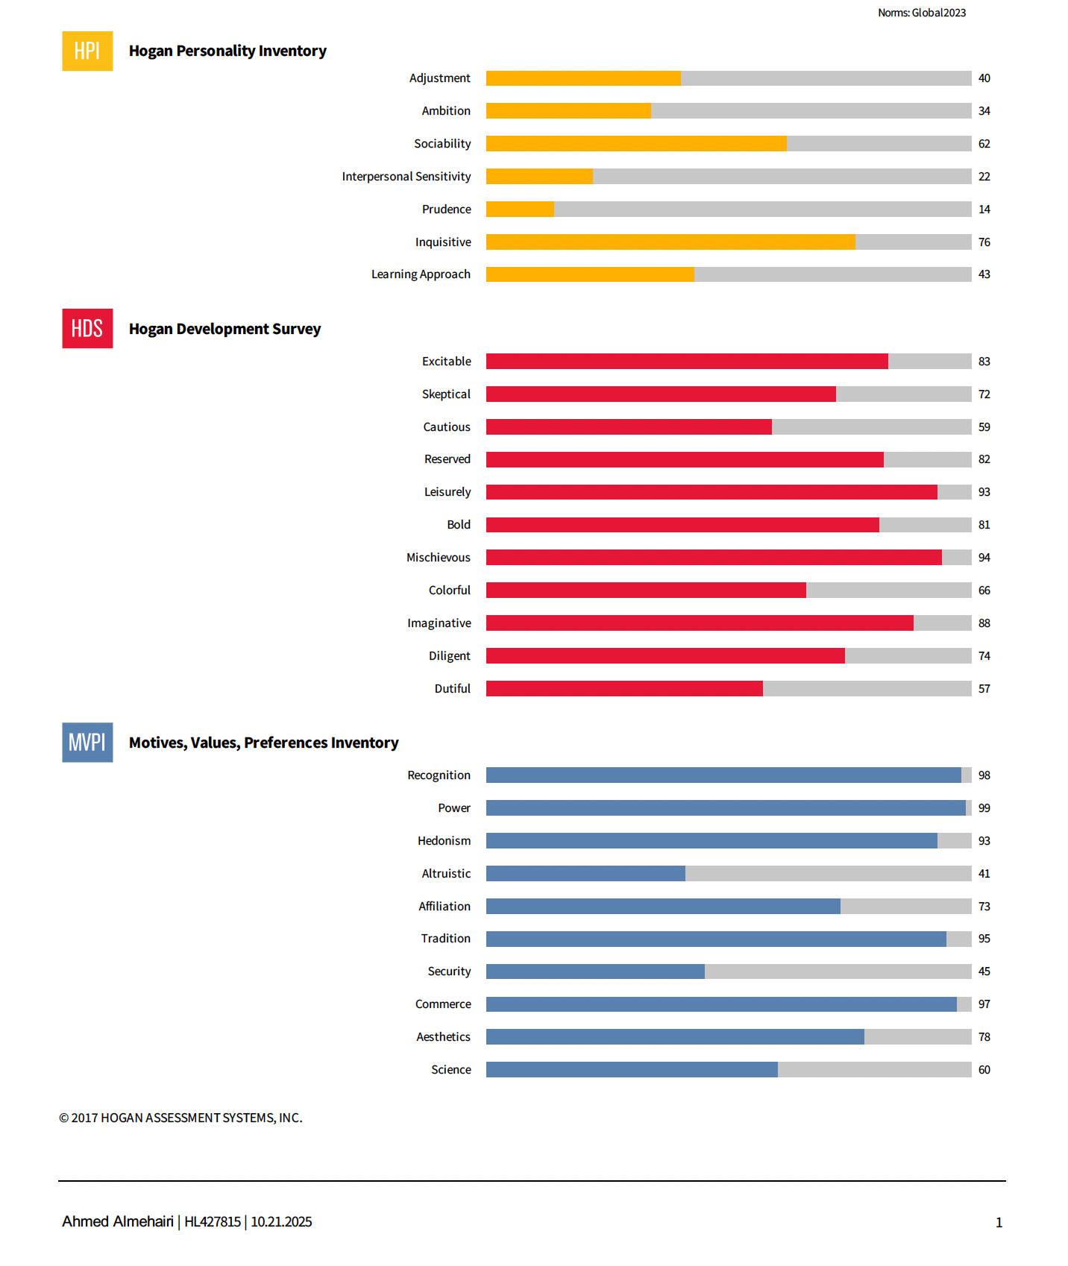
HOGAN | Group CEO | Ahmed Khalifa Almehairi
ROLE
TALENT
Group CEO
Ahmed Khalifa Almehairi
Role · Talent Match
Ahmed appears to have natural ability to do big picture thinking and create impact (Excitable, Commerce, Inquisitive). Given Ahmed’s wide-ranging interests and his enthusiasm for a multitude of endeavors (generally elevated across MVPI) he can get excited by the prospect of moving from a reliance on core CFDs to a multi-asset platform of diversified products and geographic expansion.
Ahmed should be able to rapidly diagnosing issues and, given his courage and capacity for big decisions (Bold, Power), he will be unafraid to make the tough calls.
Potential Derailers
Whilst we see plenty of drive and energy in Ahmed’s profile (elevated across HDS and MVPI) much of this suggests a singular, personal ambition and definition of success (Recognition, relatively low Altruism). He may therefore have to fight against his natural instincts if he is to be the champion of a more customer-centric culture where stakeholders and others are energized.
Similarly, he may need to be thoughful of letting go and encouraging his team to be the stars (Power, Skeptical, low Interpersonal Sensitivity), which could have implications for him decisively empowering and building trust across the executive team in the next phase of growth.
Making money is clearly a huge driver for Ahmed (Commerce), but he may not be known for being rigorous about structure and proceeses with regards to operational excellence and systems.

Slide 27
Enabling Success Plan | Group CEO | Ahmed Khalifa Almehairi
What are We Solving For?
Success Enabling Plan
Finish the Transformation
Continue tightening and refining — but it doesn’t need to dominate the agenda or messaging
Publish and track key transformation milestones and celebrate quick wins publicly to reinforce momentum and help employees see progress and value in the change.
Transition from Transformation to Growth
Align with ADQ / Board on prioritization of growth in the next phase.
Define with the Chiefs —and communicate broadly—a 12–18 month digital and commercial growth roadmap, linking technology upgrades directly to new business goals and revenue streams.
Empower a joint digital-commercial task force, including commercial, product, tech, and data leaders, charged with breaking roadblocks and delivering milestone results.
Siloed Team
The new team is mostly capable. Strengthen situational leadership by flexing style based on team maturity — move from a directive, hands-on approach with less experienced leaders to a more coaching and delegating style with more experienced ones.
As a team, map out the top 5–7 cross-functional interdependencies that are critical to delivering the business plan. Feature these in weekly meetings, with rotating “deep dives” to discuss progress, challenges, and resource trade-offs.
Define a clear weekly and monthly cadence — one forum for decisions, one voice to the organization.
Targeted team-building to replace silos with alignment, trust, and teamwork.
Support cultural integration for team members new to the UAE.
Organizational Energy
Remove remaining low performers
Identify and safeguard the Top 30-40 critical roles
Connect the support functions to Value (need to build their business acumen)
Finish the Transformation — keep improving quietly but stop letting ‘cleanup’ be the company’s story.
Transition from Transformation to Growth - Right now, too many decisions depend directly on you. That’s normal during cleanup, but it slows growth execution.
Siloed Team - Synchronizing the team around a few enterprise priorities increases speed and reduces your firefighting load
Organizational Energy - Remove underperformers and safeguard critical roles.

Slide 28
Chief Commercial
Officer | DANIEL
SQUIRES
NOV 2025

Slide 29
Jobs To Be Done | Chief Commercial Officer | DANIEL SQUIRES
Jobs To Be Done Pivot
Jobs To Be Done
Superpowers
Build an Integrated, Client-Centric Commercial Engine Unify product, marketing, and sales to deliver a seamless client experience and maximize revenue opportunities. Develop and manage a differentiated product portfolio that meets market needs and drives profitable growth. Strengthen Data-Driven Marketing and Revenue Operations Use analytics, segmentation, and funnel performance data to drive smarter commercial decisions and ROI-based marketing. Implement compensation and NCV frameworks that reward cross-functional collaboration and sustainable growth. Accelerate Client Acquisition and Brand Leadership Design and execute marketing and brand strategies that elevate visibility, trust, and client loyalty. Optimize sales coverage across client segments (Elite, HNW, Retail) to improve retention and wallet share. Elevate Leadership and Team Effectiveness Build high-performing commercial teams, develop next-generation leaders, and strengthen alignment with Digital, Risk, and Operations.
From: Siloed, transactional focus on core products and near-term KPIs
To: Integrated, data-driven commercial leadership that delivers sustained growth, diversified revenue, and scalable client engagement
Analytical Commercial Leadership: The ability to synthesize complex market data, client insights, and business trends into actionable go-to-market strategies that measurably grow revenue and client value.
Integrator & Cross-Functional Catalyst: The skill to break down silos, unite diverse teams, and drive consensus—ensuring commercial, product, and client-facing leaders execute as one cohesive unit.
WORKING DOCUMENT

Slide 30
Jobs To Be Done Match | Chief Commercial Officer | DANIEL SQUIRES
Role Pivots & Risks
The business context and feedback make it clear that success in this role depends on building trust, fostering cross-functional alignment, and influencing outcomes through collaboration
Upon joining, Dan inherited a team with high attrition. His task now is to rebuild commercial capabilities from the ground up: strengthening talent, embedding a results-focused but collaborative culture.
This role goes beyond operations — it requires understanding Middle East business culture, building strong informal networks, staying close to customers, and leading visibly and credibly to drive commercial momentum by working closely with internal teams and external stakeholders.
Is the Talent Equipped for Success?
Dan approaches challenges with intellectual curiosity and logic, motivating his team through a clear focus on outcomes and continuous learning. His analytical approach and commercial focus are genuine assets—strengths that, when combined with a compelling vision, can further inspire and align the broader team.
He is naturally more task- and business-focused than people-oriented, which can translate to limited visibility, slower relationship-building, and less proactive engagement with colleagues.
To accelerate sustainable growth, he will benefit from proactively building relationships across functions and levels; in this culture, informal influence and consensus are powerful enablers of speed, buy-in, and collective execution. He can amplify his impact by investing more in collaborative dialogue and proactive cross-functional alignment.
Balancing his drive for measurable results with disciplined attention to process and follow-through will help strengthen execution. Consistent routines and clear accountability will magnify his impact and reduce execution risk during periods of change.
He needs to be aware that the organization — and the broader Middle East context — carries elements of an entitlement culture, where comments and decisions can be easily misinterpreted— requiring mindful, culturally aware communication.

Slide 31
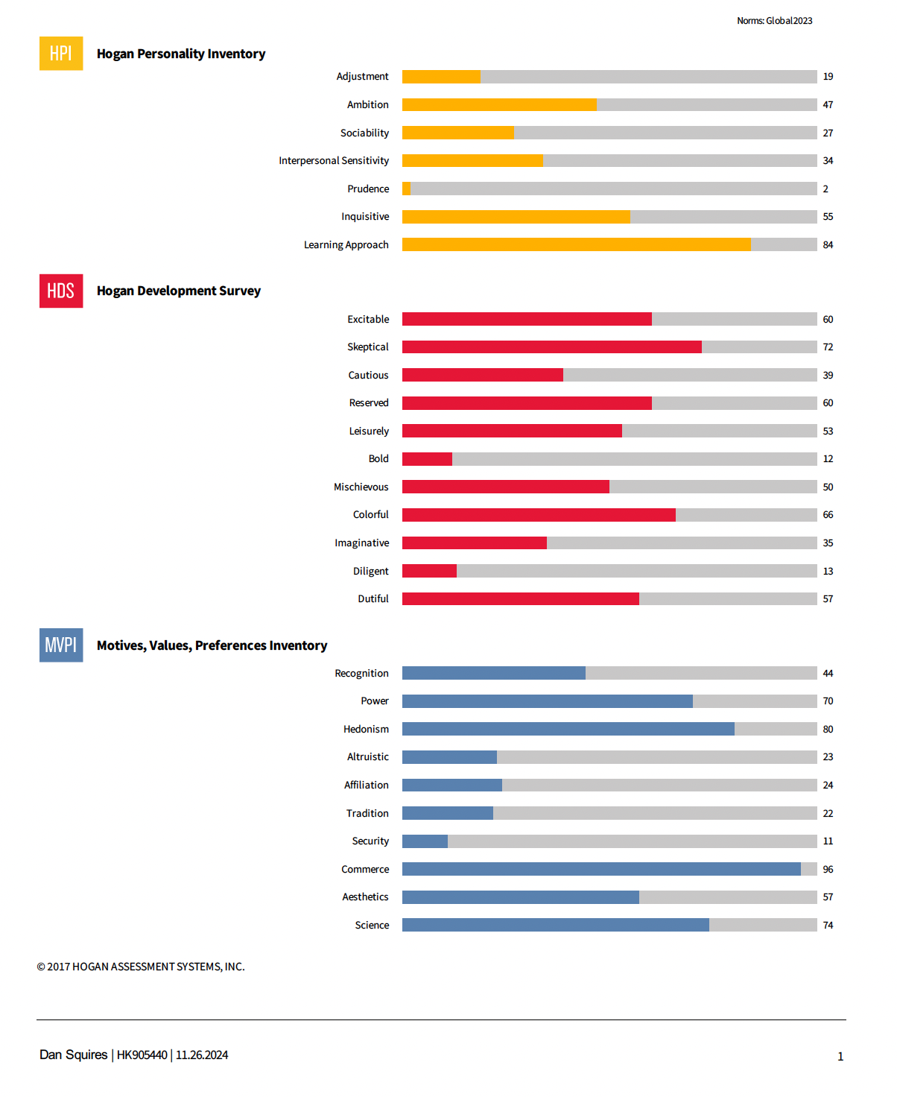
HOGAN | Chief Commercial Officer | DANIEL SQUIRES
ROLE
TALENT
Chief Commercial Officer
DANIEL SQUIRES
Role · Talent Match
Dan is likely a strong proponent of data-driven transformation (Science, low Tradition) and so should happily help drive the organization away from being product-orientated towards a more data-driven revenue-scalable engine.
Signs all point to his pace, agility and responsiveness (low Prudence, low Security, Excitable), suggesting a talent for accelerating delivery of new product launches and responding rapidly to market shifts.
Potential Derailers
Dan shows strong commercial and analytical orientation (Commerce, Science), though he may benefit from additional support in building coordination and connectedness across teams such as product, sales and marketing.
While perceptive and insightful (Skeptical, Inquisitive), it may help to have a complement in his team to strengthen process and structure and to translate ideas into practical, measurable go-to-market strategies.

Slide 32
Enabling Success Plan | Chief Commercial Officer | DANIEL SQUIRES
1. Rebuild Marketing Capabilities
2. Strengthen Team Capability, Structure, and Accountability
Identify and elevate the 3–5 most critical commercial roles that drive dipropionate growth
Act decisively on underperformance, ensuring clarity of expectations and coaching support where potential exists.
Build a structured development path for high-potential talent to strengthen leadership succession and continuity.
3. Cultural Sensitivity
Engage an experienced mentor or executive coach — ideally someone with deep Middle East commercial and cultural expertise — to refine influence, communication, and relational style.
Be more intentional about informal alignment — spending time with peers, listening for unspoken cues, and calibrating tone to build trust and sponsorship.
4. Drive Execution Discipline and Cross-Functional Integration
Create a governance rhythm with Operations, Finance, and Digital to track progress, resolve bottlenecks, and connect commercial initiatives to enterprise value creation
Complement your team with someone who can strengthen process and structure
Success Enabling Plan
What are We Solving For?
1. Rebuild Marketing Capabilities
2. Strengthen Team Capability, Structure, and Accountability
3. Culture Sensitivity
4. Drive Execution Discipline and Cross-Functional Integration

Slide 33
Head of Risk
| LUDOVIC
LOMBARD
NOV 2025

Slide 34
Jobs To Be Done | Head of Risk | LUDOVIC LOMBARD
Jobs To Be Done Pivot
Jobs To Be Done
Superpowers
Strengthen Enterprise Risk Framework and Governance Establish and continuously refine an integrated enterprise risk framework that ensures consistency, transparency, and alignment with regulatory standards and business priorities. Position Risk as a strategic enabler—balancing control with informed risk-taking. Enhance Risk Oversight Implement advanced monitoring, analytics, and limit-setting to manage exposures across trading and client portfolios. Build early-warning systems and escalation protocols to safeguard financial stability. Elevate Operational Risk Management and Resilience Identify and mitigate process, system, and human-factor risks through clear ownership, controls, and accountability. Ensure robust business continuity, crisis management, and incident-response capabilities across all functions. Integrate Risk with Commercial and Technology Functions Embed risk liaisons within business and tech teams to align oversight with commercial priorities and new product initiatives. Promote collaboration so risk management becomes a value-creation partner Build and Develop High-Performing Risk Talent Identify critical roles and upskill the team to combine technical expertise with commercial acumen. Foster a culture of curiosity, accountability, and proactive risk awareness across the organization.
From fragmented, informal, and underdeveloped practices in operational risk, cybersecurity and business continuity.
To an integrated, structured, and business-enabling risk organization built on robust frameworks, proactive culture, and high-performing specialist teams.
1. Expert at building and embedding robust risk policies and controls, turning informal practices into structured, business-enabling systems.
2. Skilled at shifting mindsets—making risk everyone’s business and driving excitement for risk as a value creator, not just a safeguard.
WORKING DOCUMENT

Slide 35
Jobs To Be Done Match | Head of Risk | LUDOVIC LOMBARD
Role Pivots & Risks
The role must evolve to becoming a commercial partner that enables better, safer business decisions. This requires building a technically strong, commercially aware team that can both challenge and support business leaders.
Many processes still depend on informal practices rather than structured, documented frameworks. While formalization efforts have begun, consistent communication and disciplined follow-through are essential to strengthen governance and reliability.
Cross-functional silos continue to limit Risk’s visibility and impact. The role must actively foster collaboration and ensure risk insights are fully integrated into enterprise decision-making and strategic growth initiatives.
Is the Talent Equipped for Success?
Ludovic’s technical expertise and disciplined approach are clear strengths—raising the standard for risk management at ADSS and providing a strong foundation for future impact.
To maximize his influence, he should continue to focus on positioning risk as a strategic business partner—not merely a compliance checkpoint—by proactively engaging commercial, technology, and support teams in meaningful dialogue about risk and value creation.
He continues to make progress by formalizing and documenting risk policies and procedures. Sustaining this work, and moving further away from informal or unwritten rules, will help establish greater transparency, consistency, and credibility across all risk domains.
Actively seeking opportunities to build trust and cross-functional collaboration will enhance his authority in risk management; his impact grows when he bridges silos with peers and stakeholders.
By dedicating time to understanding ADSS’s unique culture and organizational norms—observing team dynamics, local decision-making styles, and building personal relationships—he will increase his effectiveness, strengthen buy-in for risk initiatives, and accelerate cultural integration.

Slide 36
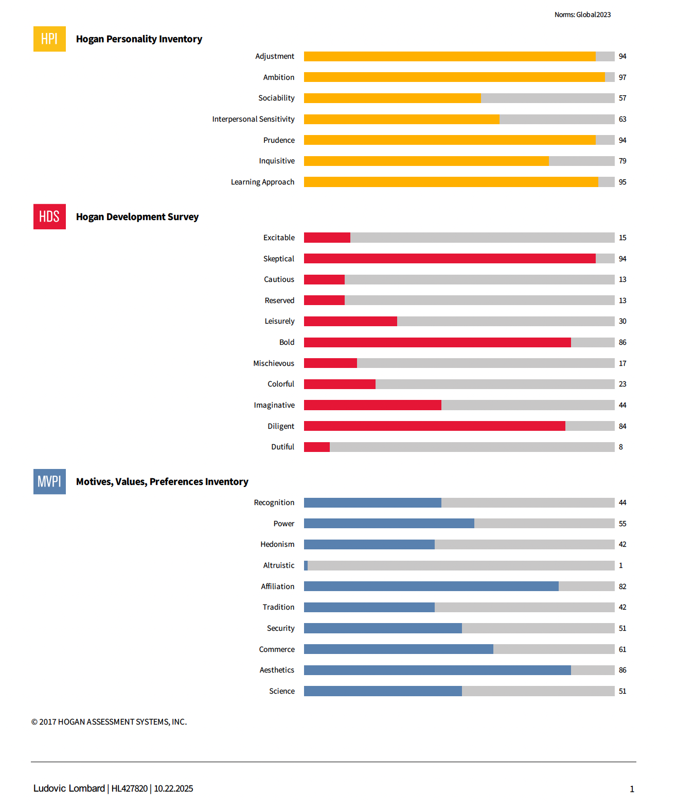
HOGAN | Head of Risk | LUDOVIC LOMBARD
ROLE
TALENT
Head of Risk
LUDOVIC LOMBARD
Role · Talent Match
Ludovic clearly has some pronounced natural talents with regards to excellence and operational risk (Diligent) and with his sharp, probing mind (Skeptical) he likely knows where the threats are and what defenses are needed to create a robust and resilient risk-management culture.
Moreover, he is strongly oriented towards building structures and processes (Prudence) which augurs well for him establishing a secure and enduring risk management framework.
Not just a behind-the-scenes risk manager, Ludovic should be a visible and influential figure across the entire business as he confidently shifts mindsets around risk (Bold, Affiliation).
Potential Derailers
Ludovic may not be investing as much as he could in coaching and developing the next generation of leaders in his team. He might not yet be known as a natural delegator (Skeptical) or someone who prioritises the career progress of people in his team (low Altruism).
Additionally, his pronounced confidence might make it hard to challenge him or for other experts to advise him (Adjustment, Bold)
Notes:
Head of Risk

Slide 37
Enabling Success Plan | Head of Risk | LUDOVIC LOMBARD
Success Enabling Plan
What are We Solving For?
1. Strengthen Ludovic’s ability to lead and influence across cultural and functional boundaries.
2. Rebuild credibility of the Risk function as a trusted enabler
3. Upgrade team quality, capacity, and engagement to meet the company’s next-phase requirements.
4. Strengthening Peer and Executive Relationships
1. Influence across Cultural and functional boundaries.
Establish a cultural bridge: pair Ludovic with a senior local sponsor or a coach to act as contextual sounding board and relationship anchor.
Sponsor Ludovic’s participation in executive program (focus: authority, trust-building in the UAE culture)
2. Repositioning Risk as a Business Partner
Redefine Risk’s operating charter jointly with CEO
Create risk liaisons embedded in major business units (commercial, operations, tech) to bridge silos.
Introduce a Risk Forum every quarter where business leaders present their own top risks and align on mitigation actions.
Simplify policies: move from audit-heavy manuals to visual “risk playbooks” that teams can understand and apply.
3. Team Capability and Performance Upgrade
Identify 3-5 critical roles and high-potential individuals to retain and develop, and plan exits the chronic underperformers.
Make accountability visible: quarterly scorecards combining technical metrics and “partnership behavior” indicators.
4. Strengthening Peer and Executive Relationships
Encourage short “pre-meet” dialogues before ExCo meetings to align on issues and avoid public tension.
Track qualitative feedback from peers on collaboration and responsiveness.

Slide 38
Head of Front
Office |
ADEEL GHIAS
NOV 2025

Slide 39
Jobs To Be Done | Head of Front Office | ADEEL GHIAS
Jobs To Be Done Pivot
Jobs To Be Done
Superpowers
From product and sales teams operating in silos with minimal cross-function support…
To fully integrated, collaborative teams where tech, legal, compliance, and sales collectively enable revenue growth
1. Drive Revenue Growth through Disciplined Trading and Market Making Maximize revenue generation across asset classes through efficient, risk-controlled trading and proactive market-making. Ensure consistent profitability by combining speed, precision, and discipline in execution. 2. Optimize Liquidity and Client Execution Strengthen relationships with liquidity providers to secure depth and quality of pricing. Optimize liquidity routing and execution strategies to deliver best-in-class outcomes for clients. 3. Strengthen Trading Risk Management and Control Frameworks Maintain robust risk oversight across all trading desks to ensure adherence to limits and governance standards. Proactively monitor exposures and enhance early-warning mechanisms to prevent operational or reputational risk. 4. Build a Data-Driven Pricing and Commercial Strategy Develop and implement pricing models tailored to client segments and market conditions. Leverage analytics to refine spreads, improve margins, and enhance competitiveness. 5. Build, Retain and Empower a High-Performing Front-Office Team Identify, develop and retain critical trading and leadership roles that drive commercial performance. Foster a culture of accountability, collaboration, and continuous learning to sustain long-term excellence.
Analytical Commercial Leadership: The ability to blend sharp data analysis and market insight with commercial acumen, enabling decisions and strategies that directly drive measurable business growth in a regulated, tech-driven environment.
Cross-Functional Influence and Integration: The skill to foster trust and orchestrate collaboration across sales, technology, compliance, and support teams—turning disparate functions into a unified, high-performing revenue engine.
WORKING DOCUMENT

Slide 40
Jobs To Be Done Match | Head of Front Office | ADEEL GHIAS
Role Pivots & Risks
The role is pivotal in leading the transformation from a single-product CFD broker into a diversified, tech-enabled regional brokerage and wealth platform. This evolution requires significant cultural, operational, and compliance adaptation, with the risk that legacy ways of working could slow progress and integration.
The front office must now evolve from a stable, execution-focused function into a proactive commercial engine that links today’s performance with tomorrow’s growth priorities. Its success depends on translating strategic ambition into coordinated delivery — working closely with Product, Marketing, Digital, and Compliance to create integrated client solutions rather than parallel initiatives.
As the business expands in complexity, the role must ensure disciplined adaptability — moving from managing established routines to shaping how the front office adopts new products, technologies, and client engagement models.
Finally, sustaining motivation and capability within the team will require structured communication, clear ownership, and well-defined development pathways that foster accountability, ambition, and continuous learning.
Is the Talent Equipped for Success?
Adeel’s leadership style is grounded in analytical rigor, commercial acumen, and resilience under pressure. He is known for his candid, straightforward approach and his ability to translate complexity into practical business action.
Adeel’s strengths lie in operational management. He is pragmatic, reliable, and able to create a clear and stable environment for his department, especially the front office. Staff value the consistency he provides during periods of major organizational change, and his leadership is credited with retaining experienced team members over many years.
He is encouraged to communicate more about long-term strategy (“Day 2” vision) and future investment priorities to create engagement and direction for the broader team. His strong operational focus could lead to siloed functioning and limited adaptability as ADSS evolves. Fostering cross-functional collaboration and preparing for future challenges are important steps for his continued effectiveness.
Under stress, Adeel can become skeptical, guarded, and rigid—behaviors that can limit collaboration and trust within newly formed teams.

Slide 41
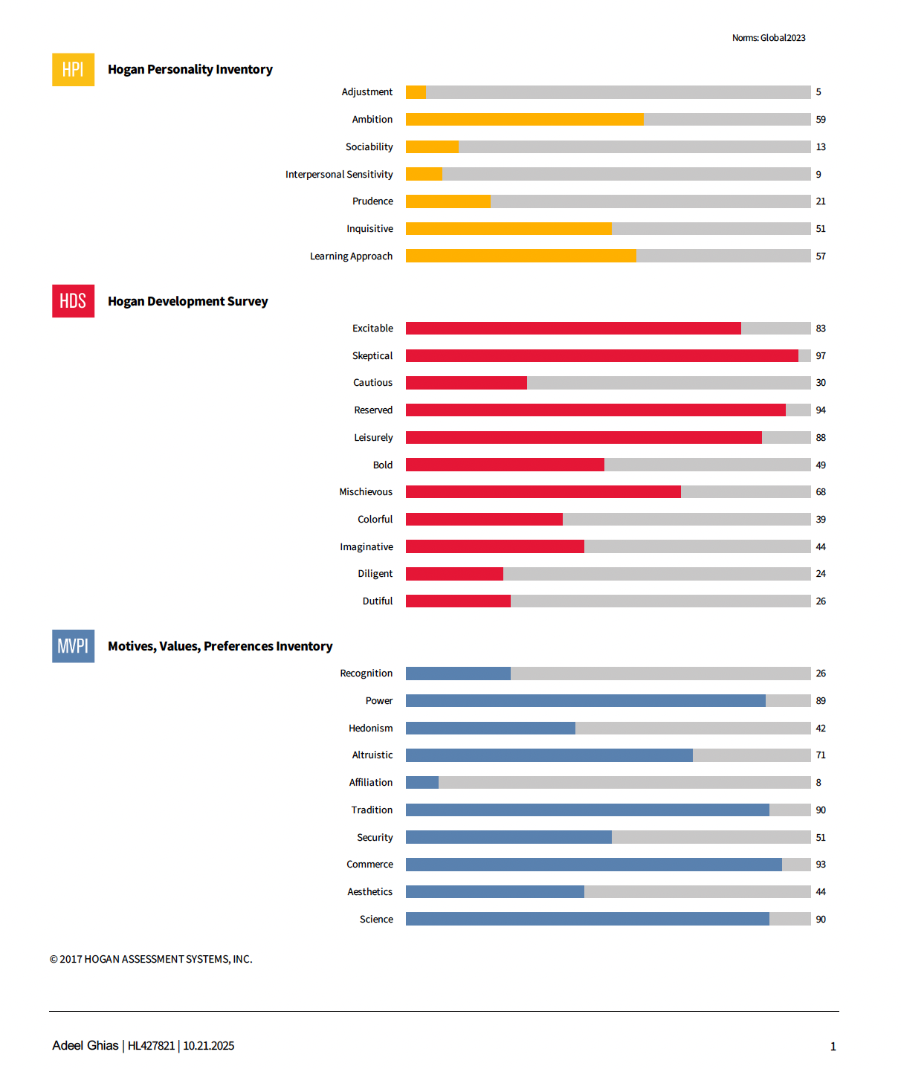
HOGAN | Head of Front Office | ADEEL GHIAS
ROLE
TALENT
Head of Front Office
ADEEL GHIAS
Role · Talent Match
Given his pace and a sharp focus on achieving superior financial returns (low Prudence, Excitable, Commerce) Adeel will likely be highly motivated to drive exceptional commercial momentum and revenue growth for ADQ.
He has natural talents in analysis and operational intelligence (Science) which combined with the above should make him a committed data-driven commercial leader.
Potential Derailers
Adeel might not be known as the most visible or collaborative of leaders (Reserved, low Affiliation) and may be rather single-minded in outlook (Leisurely). This could inhibit him from enhancing cross-functional collaboration and integration. He may struggle therefore with the breaking down of silos between sales, product, marketing, compliance and technology.
He might also be instinctively minded to do things himself (Power) and may struggle with delegation and the distribution of decision making (Skeptical). This could have consequences for the building and empowering of a high-performing team.
He scores high on Skeptical and Tradition, so he’s naturally cautious and prefers structure and predictability. This actually suits a highly regulated, risk-sensitive environment like trading. It’s probably not his natural instinct to push change quickly, but having spent years in this industry, he’s learned to be thoughtful and to balance his style by working with people who bring flexibility and new ideas.

Slide 42
Enabling Success Plan | Head of Front Office | ADEEL GHIAS
Define and Communicate a Forward Agenda
Clarify the future vision of the front office — linking today’s operational strength with tomorrow’s growth priorities.
Translate this vision into 2-3 focus themes (e.g., client growth, digital) and embed them in team and peer discussions
2. Strengthen Cross-Functional Collaboration
Establish a quarterly forum to align priorities, address bottlenecks early, and ensure new initiatives progress with both commercial speed and regulatory discipline.
Adopt a more visible, structured communication rhythm — short weekly team huddles, monthly peer syncs, and quarterly updates with broader staff.
3. Develop and Retain the Team
Identify critical roles and future successors within the team.
Build development and career paths for the Front Office Team
Success Enabling Plan
What are We Solving For?
Define and Communicate a Forward Agenda
Strengthen Cross-Functional Collaboration
Elevate Team Capability and Ownership

Slide 43
Acting Chief
Operation Officer
| VIMAL KUMAR
NOV 2025

Slide 44
Jobs To Be Done | Acting Chief Operation Officer | VIMAL KUMAR
Jobs To Be Done Pivot
Jobs To Be Done
Superpowers
Strengthen the Operational Backbone for Scale Ensure efficient, compliant, and scalable operations across back office, middle office, and client onboarding. Embed process discipline, automation, and controls to support growth and operational reliability. Drive Cross-Functional Alignment and Execution Discipline Establish structured routines, KPIs, and information flow across Operations, Finance, and Commercial to ensure coordination and timely delivery. Enhance Client Experience through Seamless Service Delivery Streamline onboarding, documentation, and reconciliation processes to deliver a frictionless client experience. Reduce errors and response time by connecting front - middle- and back-office workflows. Optimize Procurement and Vendor Partnerships Implement strategic sourcing and vendor management frameworks to improve cost efficiency, transparency, and value creation. Ensure procurement supports business continuity and operational agility Build and Elevate Operations Capability Identify and develop the 3–5 most critical roles that sustain operational excellence. Strengthen accountability, upskill teams, and build successors capable of maintaining performance at scale.
From reactive, legacy-oriented back-office management and siloed operations
To proactive, process-driven, accountable operational leadership that enables growth ambitions, cross-functional execution, and readiness for future transformation.
Process Discipline & Operational Reliability: The capacity to bring clear structure, rigor, and dependable delivery to all operational functions, enabling stability during rapid transformation.
Change Agility: The ability to improve processes and to learn and adapt rapidly when confronted with new challenges.
WORKING DOCUMENT

Slide 45
Jobs To Be Done Match | Acting Chief Operation Officer | VIMAL KUMAR
Role Pivots & Risks
The role requires balancing the need for operational reliability with the pressure to innovate and streamline, particularly as new digital systems and cross-functional workflows are introduced.
Resistance is likely to arise where long-standing team habits or comfort with the status quo make it hard to adopt new approaches or question legacy practices. Successfully shifting mindsets—encouraging openness to change, continuous improvement, and constructive challenge—will be critical for delivering sustainable operational value and supporting ADSS’s wider transformation goals.
Is the Talent Equipped for Success?
Vimal is widely acknowledged for his dedication and reliability—regarded as a true “workhorse” who reliably delivers under pressure, enforces process discipline, and brings essential structure to operational and transformation priorities at ADSS. His readiness to tackle difficult assignments have proven invaluable in navigating complex transitions.
Seeks recognition, influence, and meaningful impact; he is energized by delivering measurable results in an environment that values autonomy
His drive for meaningful results and high standards serves ADSS well; applying the same commitment to leading process updates, supporting team learning, and recognizing the broader impact of operations will amplify both his legacy and the value delivered across the business.
As our environment becomes more digital and dynamic, the greatest impact will come from not only maintaining this stability but also being willing to set the tone for questioning what no longer works and supporting the shift toward new, streamlined ways of doing things.
Sometimes, when things get busy or frustrating, your preference for independence and quick action might be read as distance by others—staying visible and approachable, especially during tough transitions, will keep the team motivated and connected.
There is a perception that in an effort to strengthen his influence, he has sometimes over-used his network power - this reduces the trust.

Slide 46
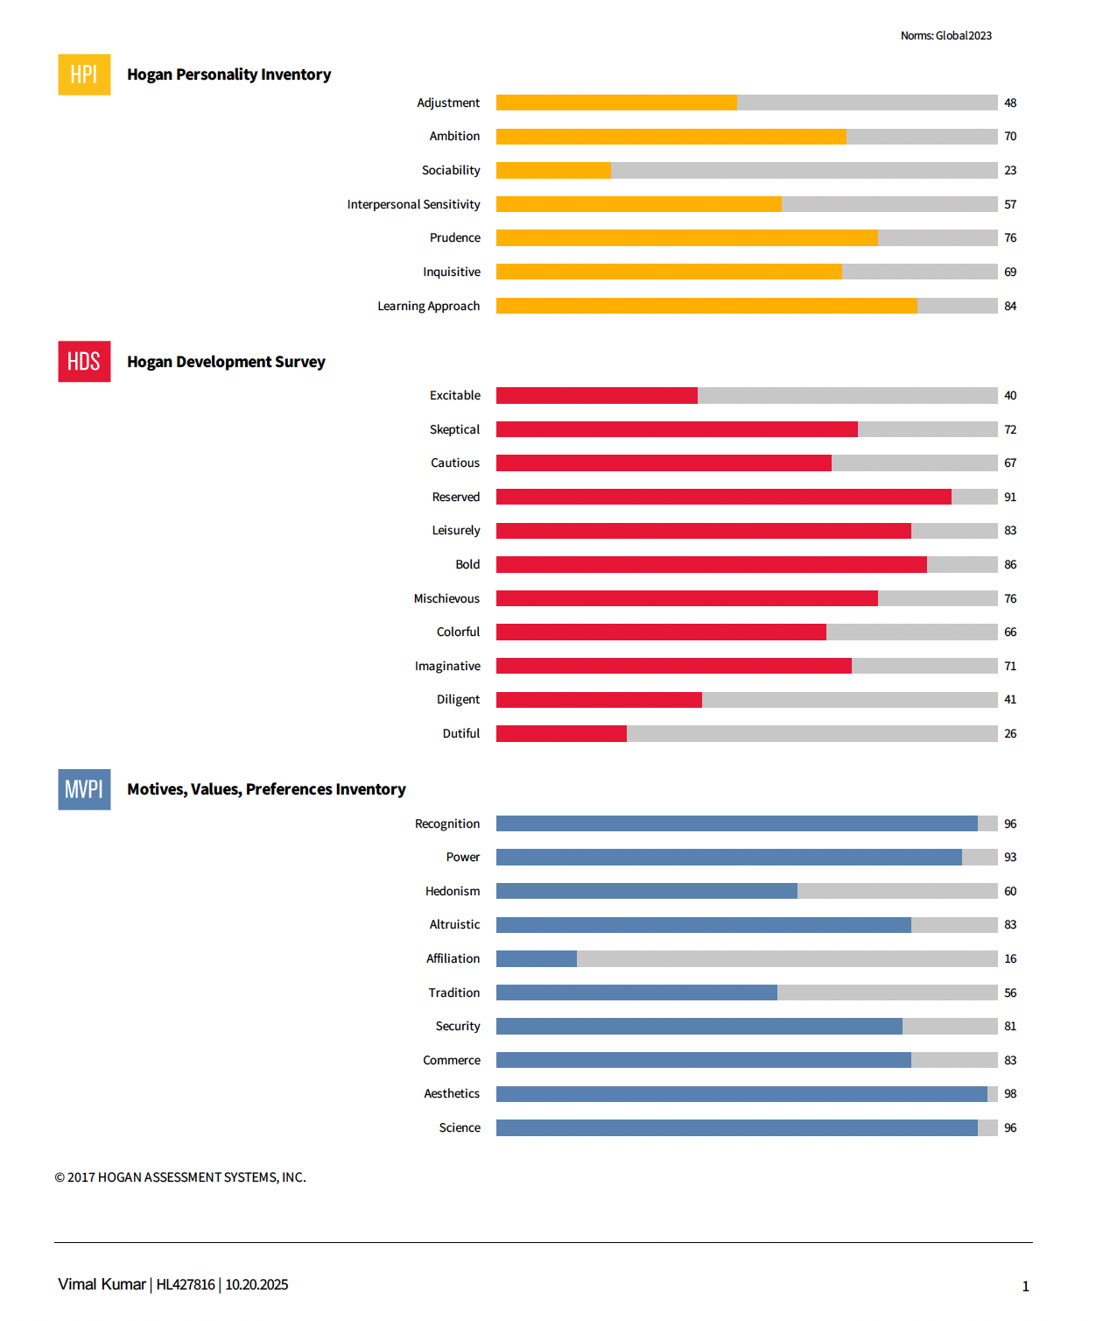
HOGAN | Acting Chief Operation Officer | VIMAL KUMAR
ROLE
TALENT
Acting Chief Operation Officer
VIMAL KUMAR
Role · Talent Match
Profiling as a talented operator for whom rigour and structure are key features of his thinking (Prudence, Security) Vimal will likely naturally pivot towards proactive, process-driven operational leadership.
Empirical and insight-driven (Science, Learning Approach) Vimal should excel at closing operational gaps by utilizing data, analytics and continuous improvement mindsets.
He has some useful leadership qualities, which should help in the upskilling of his team (Altruistic) and the fostering of a culture of accountability (Power).
Potential Derailers
The key challenges for Vimal seem to be around visibility (Reserved, low Affiliation) and transparency (Leisurely). Together this could have consequences for how he supports cross-functional collaboration with commercial, technology and risk partners.
Despite some potentially valuable leadership qualities, Vimal may still view success primarily through the lens of personal achievement (Recognition, Bold). To truly excel, he could benefit from recognising that lasting success is built on shared accomplishments and the collective strengths of the team.

Slide 47
Enabling Success Plan | Acting Chief Operation Officer | VIMAL KUMAR
Position Operations as a Growth Enabler
Simplify and modernize core processes to drive both efficiency and agility.
Position Operations as a strategic enabler of growth by embedding digital tools, data visibility across workflows.
Champion a culture of continuous improvement
2. Upgrade Team Capability and Focus on Critical Roles
Identify and elevate the 3–5 roles most essential to transformation success, ensuring they are led by capable, high-impact performers.
Address underperformance with clarity and fairness, while actively developing next-generation leaders through mentoring, targeted upskilling, and clear career paths.
Build development and career paths for the Operations team
3. Elevate Leadership Presence with Peers and Team
Externally and with your peers, act as a connector across the leadership table — bringing stability, clarity, and forward momentum to cross-functional priorities.
Continue to delegate effectively to your team, while directing and challenging them when needed. Given the transformation underway keep pushing the team for higher standards will be essential
Success Enabling Plan
What are We Solving For?
1. Position Operations as a Growth Enabler
2. Upgrade Team Capability and Focus on Critical Roles
3. Elevate Leadership Presence with Peers and Team

Slide 48
Acting CFO |
AMMAR AZHAR
NOV 2025

Slide 49
Jobs To Be Done | Acting CFO | AMMAR AZHAR
Jobs To Be Done Pivot
Jobs To Be Done
Superpowers
Strengthen Financial Discipline and Strategic Resource Allocation Drive greater discipline in cost management without stifling innovation — balancing efficiency with investment in growth. Ensure resources are deployed strategically to maximize returns and enable sustainable value creation. Enhance Financial Planning, Forecasting, and Decision Support Develop robust forecasting, budgeting, and performance management processes to improve business predictability and accountability. Translate financial insights into actionable strategies that drive cross-functional alignment and informed decision-making. Ensure Robust Controls, Compliance, and Transparency Maintain strong financial governance, accounting accuracy, and regulatory compliance across all jurisdictions. Enhance financial reporting and audit readiness to strengthen stakeholder trust and integrity. Optimize Cash and Capital Management Safeguard liquidity and balance sheet strength through proactive cash, funding, and risk management. Develop capital allocation strategies that support both operational resilience and long-term growth ambitions. Build and Elevate Finance Capability Identify and develop critical roles within Finance to close capability gaps and strengthen collaboration with other functions.
Decisive, Commercial Influence: The capacity to assertively align stakeholders, cut through ambiguity, and drive consistent, actionable communication—ensuring decisions are translated into clear direction, unified priorities, and measurable business impact.
Technical and Institutional Mastery: The ability to leverage deep financial expertise and anticipate challenges, drive sound decision-making, and stabilize the organization through complex transitions.
From managing legacy issues, dependencies, and transactional reporting
To a commercially assertive, institutionally influential leader who proactively drives cross-functional alignment, clear communication, and decisive execution that balances cost discipline with growth ambitions
WORKING DOCUMENT

Slide 50
Jobs To Be Done Match | Acting CFO | AMMAR AZHAR
Role Pivots & Risks
There is currently misalignment between cost control and growth priorities. The role is central to aligning leadership around one financial narrative — clarifying trade-offs, building consensus, and ensuring resources are deployed where they create the most value.
Finance must also evolve from a control-oriented function to a driver of cross-functional effectiveness. The role should work closely with peers in Commercial, Operations, and Digital to align plans, strengthen execution, and ensure financial priorities are understood, owned, and acted upon across the enterprise.
Is the Talent Equipped for Success?
Ammar is a technically strong and commercially astute leader and a steady hand through multiple transformation phases. His calm presence, accessibility, and practical mindset have built trust and stability—qualities the organization values during change.
His greatest opportunity lies in extending that credibility beyond Finance—building a stronger bridge with his peers, his team and the organization.
His strong personal drive and high standards sometimes lead him to take on too much himself, so expanding his comfort with delegation and relational leadership would help him leverage his team more fully. Strengthening these capabilities will enable him to build an even more empowered, connected team and deepen collaboration across functions.
His Hogan profile reflects strong confidence, commercial drive, and clear leadership ambition. Recognize that, under pressure, he may lean toward skepticism or impatience, which can reduce attention to interpersonal dynamics. He will be most effective when he channels his assertiveness into constructive influence and positions himself as a steady, stabilizing leader among his peers. Becoming a stronger thinking partner to the CEO and increasing his voice and presence within the leadership team will further enhance his impact.

Slide 51
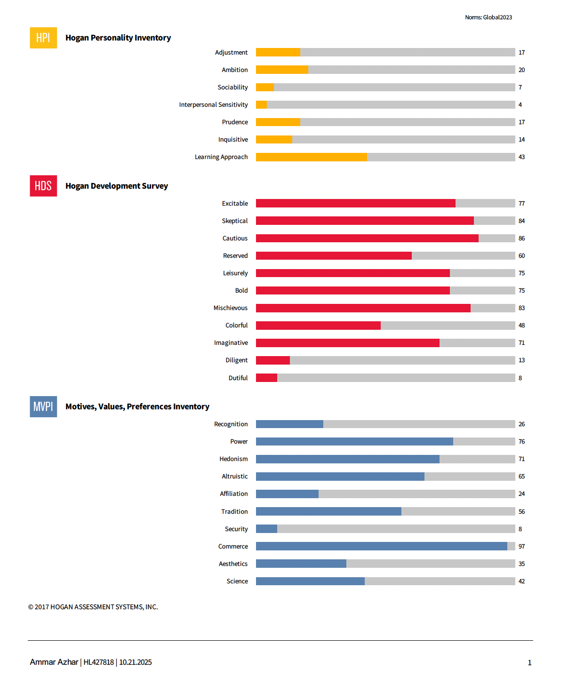
HOGAN | Acting CFO | AMMAR AZHAR
ROLE
TALENT
Acting CFO
AMMAR AZHAR
Role · Talent Match
Likely to be financially astute and technically accomplished Ammar is probably particularly adept at the governance, stewardship and controls elements of the CFO role (Commerce, Cautious).
His skills in this respect should also help him with investment evaluation (Skeptical) and ethical and fiduciary responsibility (Altruistic).
Potential Derailers
Ammar might not be naturally given to assertively driving cross-functional alignment (low Sociability, low Ambition) and is probably less visible and connected than he could be (low Affiliation)
Leadership might be an under-developed area for Ammar. He may struggle with delegation (Skeptical) and empathy (low Interpersonal Sensitivity). Combined this could inhibit him building and developing a talented team who need to collaborate effectively with other functions.
There are some questions about how measured Ammar is under pressure (low Adjustment, elevated across HDS, especially Excitable) which could have bearings how sound his decision-making is and how he helps stabilize the organization through complex transitions.

Slide 52
Enabling Success Plan | Acting CFO | AMMAR AZHAR
1. Drive Both Cost and Growth
Facilitate structured discussions with the CEO and CCO to define a unified financial philosophy — balancing cost discipline with growth investment.
Champion a “1 dirham, 1.01 decision” mindset — ensuring spending is directly tied to measurable business outcomes.
2. Upgrade Team Capability and Performance
Conduct a targeted talent and structure review to identify 3–5 pivotal roles critical to future value delivery.
Upskill the team in business partnering and provide the Finance team with clear development plans
3. Increase Communication To and From the Business
Ensure two-way flow: set up feedback channels where business units can raise issues and request finance support early.
Build predictable communication rhythms — weekly team check-ins, monthly updates, and quarterly town halls to sustain clarity through change.
4. Be a thinking partner for the CEO - Increase your voice and presence within the leadership team
5. Strengthen Peer Relationships and Cross-Functional Alignment
Build a relationship map to identify areas of tension or misalignment and proactively address them through joint workshops or 1:1 dialogue.
Success Enabling Plan
What are We Solving For?
1. Drive Both Cost and Growth: Finance as the engine of disciplined cost control and growth
2. Upgrade Team Capability and Performance: Build a forward-looking, agile finance team capable of supporting both transformation and growth.
3. Increase Communication To and From the Business: Create transparency, confidence, and shared accountability through consistent, clear financial communication.
4. Be a thinking partner for the CEO
5. Strengthen Peer Relationships and Cross-Functional Alignment

Slide 53
Chief Information
Officer |
CHRISTOFFER
ROSENKILDE
NOV 2025

Slide 54
Jobs To Be Done | Chief Information Officer | CHRISTOFFER ROSENKILDE
Jobs To Be Done Pivot
Jobs To Be Done
Superpowers
Define and Execute the Digital Transformation Strategy Design and deliver a clear technology roadmap that aligns with business goals — balancing short-term delivery needs with long-term scalability and innovation. Ensure every digital initiative directly enhances client experience, speed, and operational resilience. Modernize Technology Architecture and Infrastructure Transform legacy systems into a unified, agile, and secure technology backbone. Embed scalability, reliability, and performance across platforms to support multi-product growth and seamless execution. Strengthen Cybersecurity and Risk Management Implement enterprise-wide security frameworks, continuous threat monitoring, and incident response readiness. Protect systems, data, and client assets while maintaining compliance and trust with regulators and partners. Advance Data Management and Analytics Capabilities Build robust data governance and analytics platforms that turn information into actionable insights. Enable data-driven decision-making across commercial, operational, and client-facing teams. Build and Elevate Technology Talent and Influence Identify and develop critical technology and data roles; close capability gaps through targeted hiring and upskilling. Foster a collaborative, high-performing culture — one that blends innovation, accountability, and strong cross-functional alignment with business leaders.
From: Siloed, legacy technology support and reactive development.
To: Proactive, integrated digital leadership—embedding technology at the core of strategy, driving scalable innovation, and directly enabling business growth.
Strategic Digital Vision and Delivery: The capacity to translate forward-thinking digital objectives into tangible, business-enabling platforms, integrating data, automation, and technology with growth targets.
Relational Influence and Cultural Adaptation: The ability to build trust, manage up, adapt communications, and navigate relationship-driven cultures, so technology becomes central to decision-making and business partnership.
WORKING DOCUMENT

Slide 55
Jobs To Be Done Match | Chief Information Officer | CHRISTOFFER ROSENKILDE
Role Pivots & Risks
The role is central to transforming the company’s digital backbone from fragmented, legacy systems into integrated, business-driven solutions that enable growth, scalability, and efficiency. Success depends on the ability to turn technology into a visible enabler of commercial strategy — linking digital priorities directly to business outcomes.
The biggest risk lies in ongoing misalignment across the senior leadership team — when platforms and investment priorities are not fully shared, the technology agenda risks loss of pace. Clear alignment and sponsorship from the top are critical to sustain momentum and deliver enterprise-wide value.
To be most effective, the role must bridge technical insight and business relevance — translating complex solutions into clear, actionable priorities that peers and business leaders understand, support, and adopt. Without active engagement and consistent communication with the CEO and peers, technology decisions risk being seen as functional rather than transformational.
Finally, the role operates within a culture where informal influence and relationship capital matter as much as technical capability. Navigating these dynamics deliberately — cultivating trust, clarity, and shared accountability — is essential to ensure that strong technical solutions gain the sponsorship and follow-through needed for lasting impact.
Is the Talent Equipped for Success?
Chris brings deep industry and technical expertise, offering sector-relevant insights and a pragmatic, thoughtful leadership style. He is valued for his operational steadiness and for driving progress in data, analytics, and platform capabilities, with a strong orientation toward building for the future.
To maximize his impact, he will benefit from strengthening relationships upward with the CEO and laterally across the C-suite. Translating technology priorities into business outcomes—and adapting his communication to local norms—will help increase influence with non-technical leaders.
Given ADSS’s relationship-driven culture, his highly rational communication style can sometimes be misread. Flexing his approach, investing in relational influence, and pursuing early consensus will support stronger alignment and buy-in.
He should stay anchored in his strengths—purpose-driven leadership, calm resilience, and commitment to meaningful solutions—while remaining visible, accessible, and engaged across the organization, particularly when alignment or trust is uncertain.
Under stress, Chris may become more cautious or withdrawn, which can slow decision-making. Maintaining open dialogue and visible engagement during these moments will reinforce confidence within his team and among peers.

Slide 56
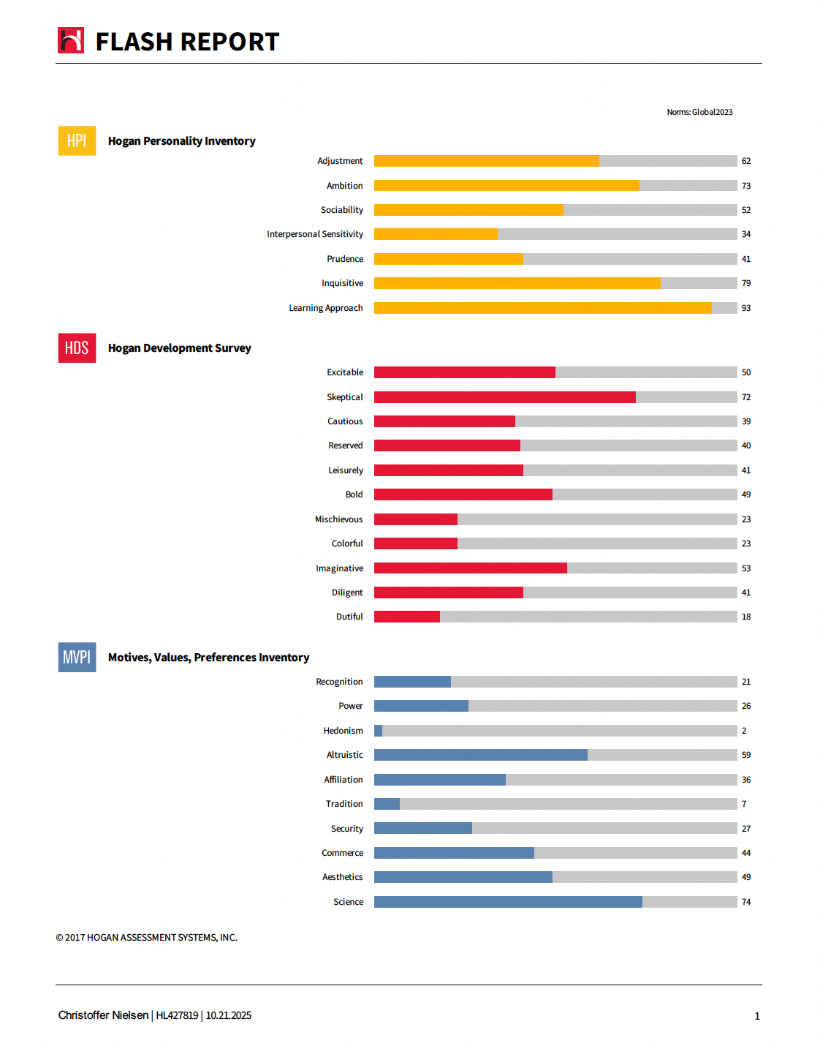
HOGAN | Chief Information Officer | CHRISTOFFER ROSENKILDE
ROLE
TALENT
Chief Information Officer
CHRISTOFFER ROSENKILDE
Role · Talent Match
Christoffer is probably far-sighted in outlook and may be ahead of the curve with regards to technology, data and digital leadership (Learning. Approach, Inquisitive, Science). This all augurs well for him building a future-focused strategy to allow for integration, automation and product diversification.
Christoffer may be known as a generous and supportive leader (Altruism) who should therefore be motivated to build, upskill and retain a high-performing technology and data team. This should help also with addressing resourcing gaps and take account of future scaling.
Potential Derailers
An area of development for Christoffer may be around his confidence at asserting himself (low Power, low Colorful), which could inhibit his relational influence and cultural adaptation. Building trust (Skeptical) and adapting communications (low Mischievous) might also be underdeveloped skills.

Slide 57
Enabling Success Plan | Chief Information Officer | CHRISTOFFER ROSENKILDE
Clarify the Digital Strategy: Provide visibility on progress, decisions, and business impact to build clarity and trust that technology is enabling today’s results while shaping tomorrow’s growth.
Build your relations with the CEO and your peers
Engage the CEO with a focused, outcome-driven digital strategy conversation — clearly separating immediate fixes from medium- and long-term transformation priorities. Provide visibility on progress, decisions, and business impact to build clarity, confidence, and trust that technology is enabling today’s results while shaping tomorrow’s growth.
Use regular one-on-one touchpoints with the CEO and peers to align on priorities and strengthen advocacy for key initiatives.
3. Close Talent and Skills Gaps in the Technology & Data Teams
Conduct a thorough skills audit within the technology and data functions to identify critical gaps— and prioritize recruitment, upskilling, and targeted external hires.
4. Deepen Cultural Integration and Leadership Presence
Increase awareness of local cultural dynamics and informal influence patterns to enhance effectiveness within the organization.
Engage an external mentor or executive coach to refine communication tone, relational adaptability, and informal influencing skills.
Be intentional about showing warmth, accessibility, and curiosity — balancing analytical strength with relational empathy to build stronger sponsorship and followership.
Success Enabling Plan
What are We Solving For?
1. Clarify the Digital Strategy
2. Build relations with the CEO and peers
3. Close Talent and Skills Gaps in the Technology & Data Teams
4. Deepen Cultural Integration and Leadership Presence

Slide 58
THANK YOU

